Slide 1

Capstone Project - Two “How Much should I Charge?” A Price Prediction Model for NY Airbnb Listings
Brintha Subramaniam
Data Science Career Track - Springboard

Slide 2

Problem Identification
Airbnb:
An online marketplace for vacation rentals, and homestays.
Enjoys around 5% of the tourism accommodation revenue.
So, what’s the problem?
Setting a price for listings - challenging task for Airbnb hosts
Inefficient pricing - resulted in loss of 46% of additional revenue among some hosts.

Slide 3


Project Objective
What’s the deliverable - Price Prediction Model
For who – New hosts from New York area
What are the factors that will be considered:
Location of listing
Housing type
Available amenities
Number of rooms/bathrooms/bedrooms
Reviews about the listing
Rating

Slide 4
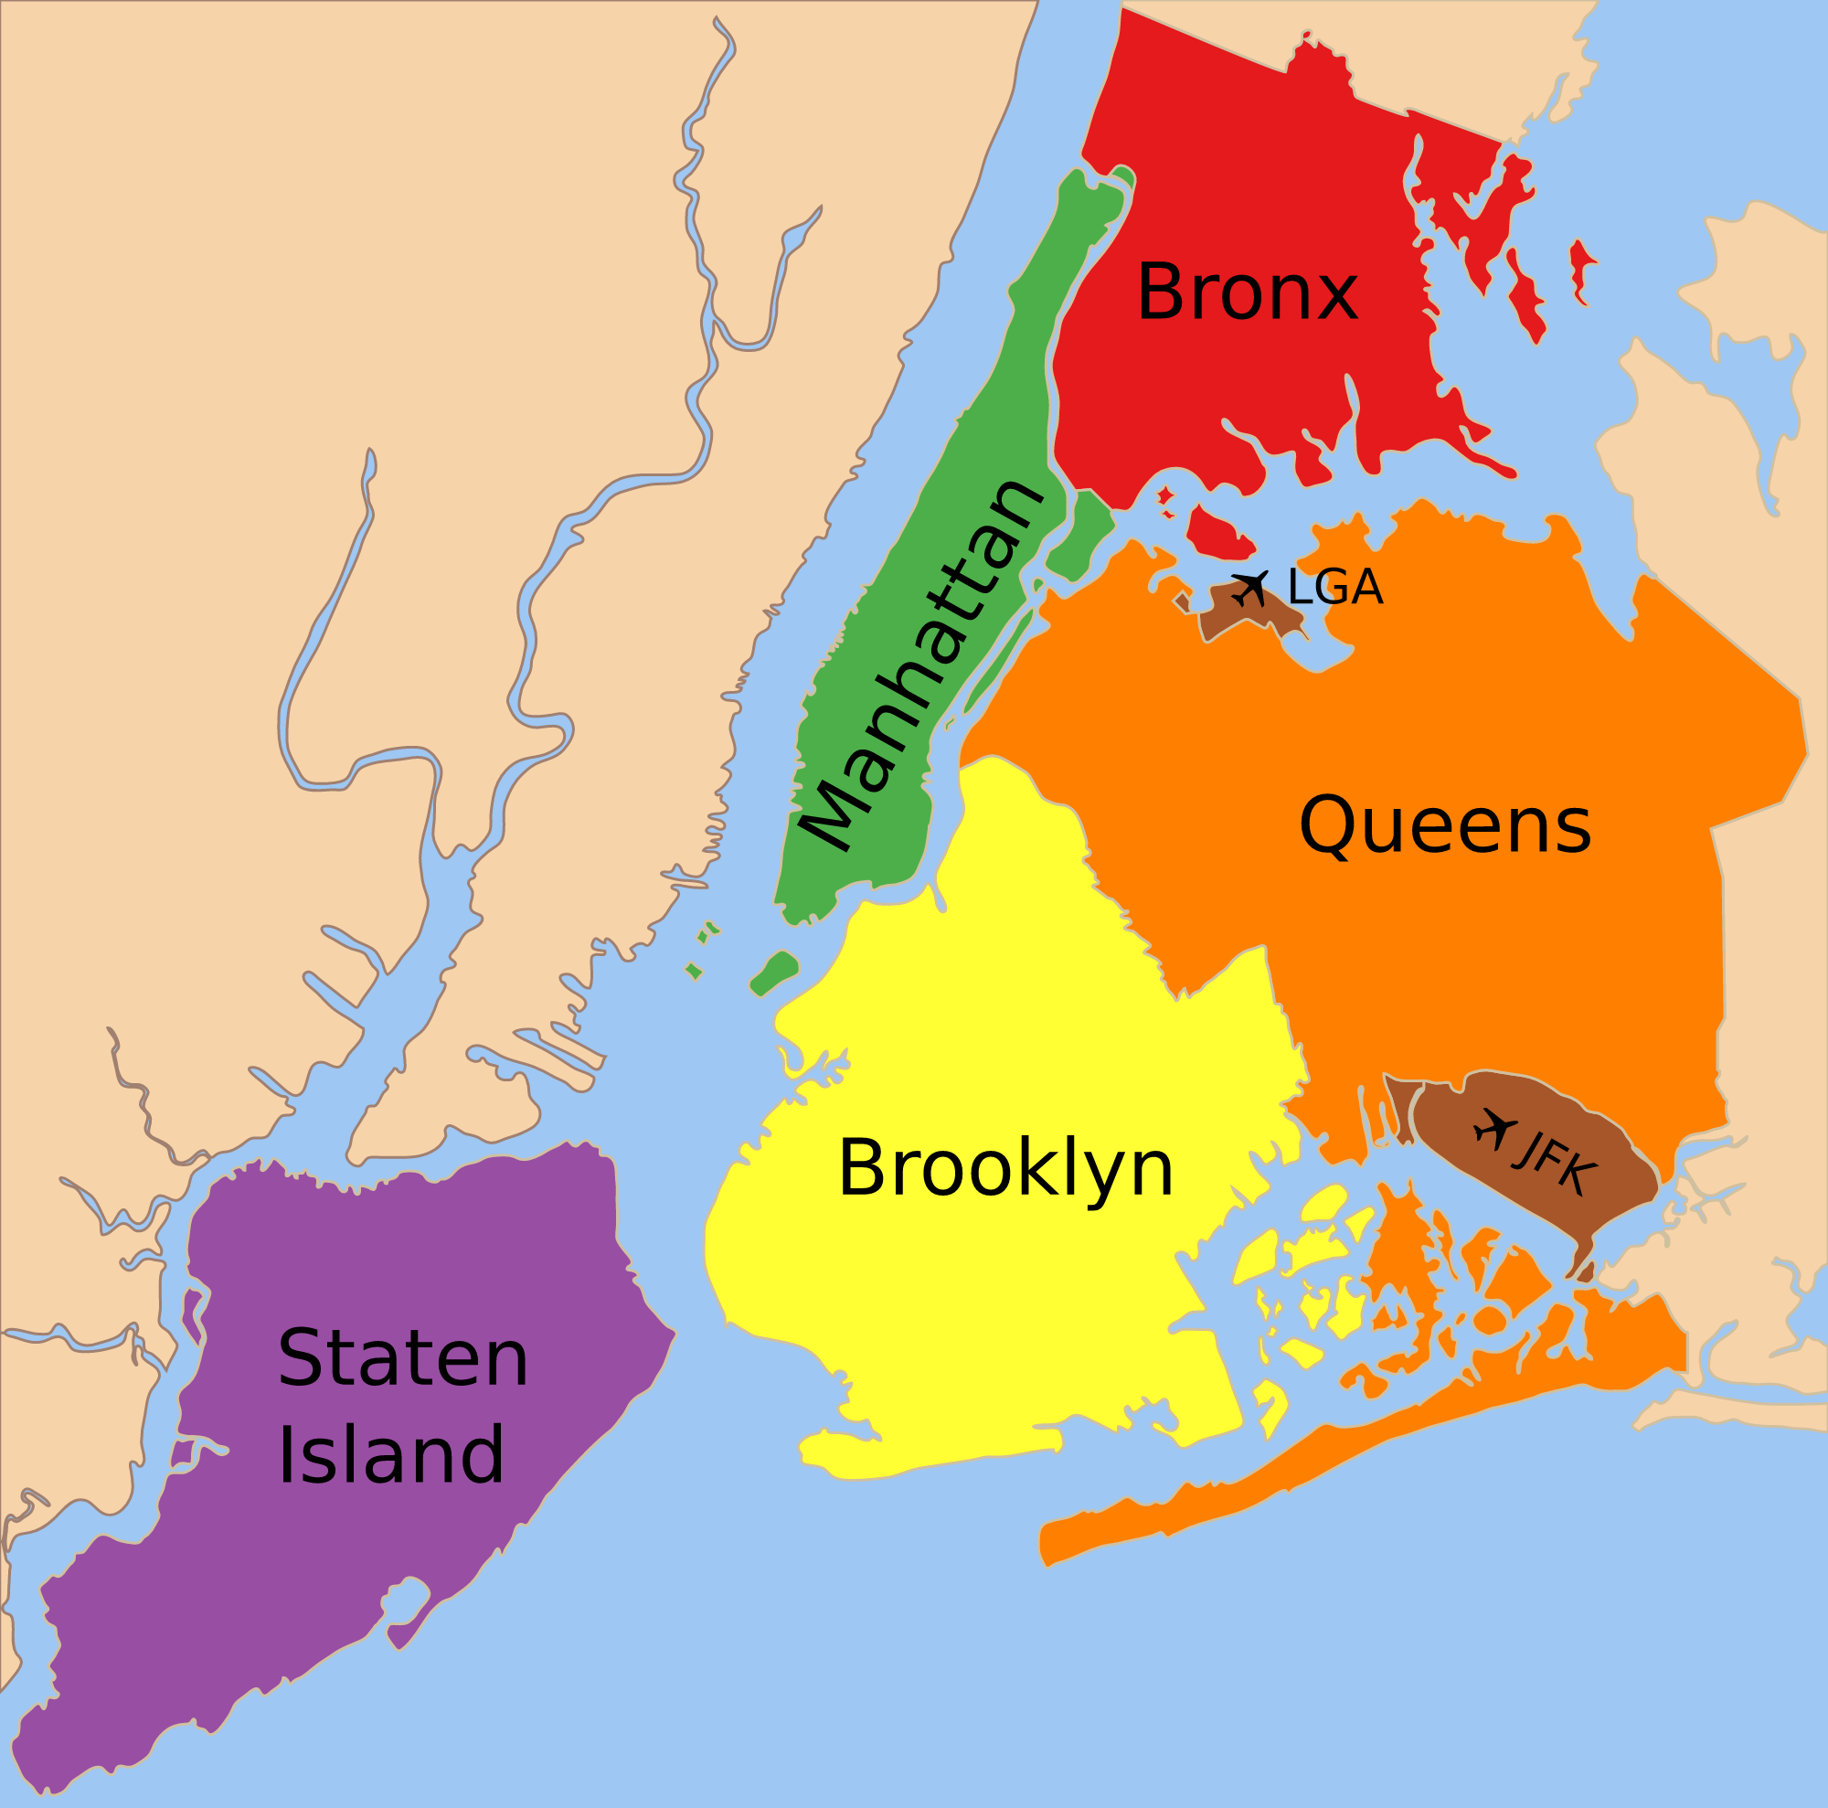
Data and Method
Data Source: Inside Airbnb
http://insideairbnb.com/get-the-data.html
Approx. 36,000 listings (36,000 rows)
Manhattan
Brooklyn
Queens
Bronx
Staten Island
Covers early periods of April 2021
72 columns - details of listing, information about host

Slide 5
Exploratory Analysis
Missing data: missing at random; all with <10% missingness, imputed with suitable values
Features for Analysis:
Numeric Features | Dummy Features
Number of Bathrooms | Instant_Bookable
Number of Bedrooms | Host_is_superhost
Number of Amenities | Room_type_Entire home/apt
Number of Beds | Room_type_Hotel room
Rating | Room_type_Shared room
Number of Reviews | Neighbourhood_group_Manhattan
Number of Accommodates | Neighbourhood_group_Brooklyn
 | Neighbourhood_group_Queens
 | Neighbourhood_group_Bronx

Slide 6
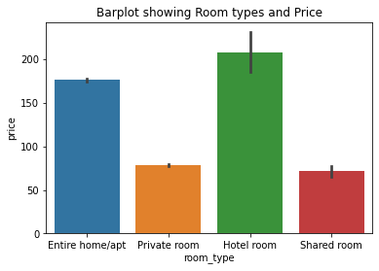
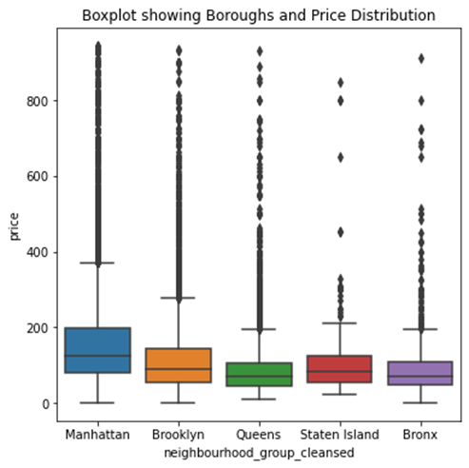
Exploratory Analysis
Price and Room type
Price and Location

Slide 7
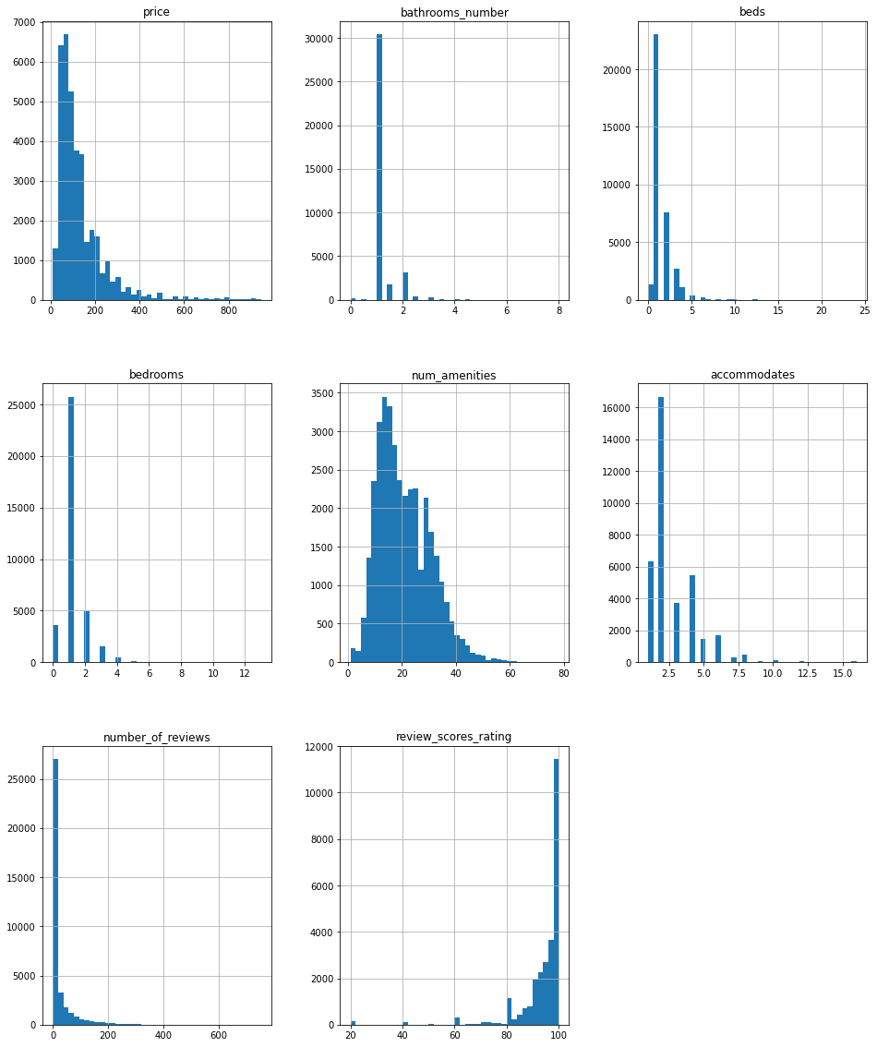
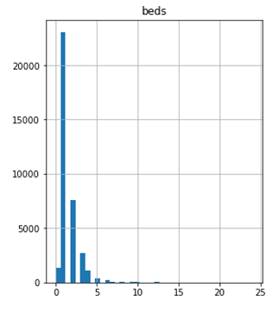
Distribution of Price and Other Features

Slide 8
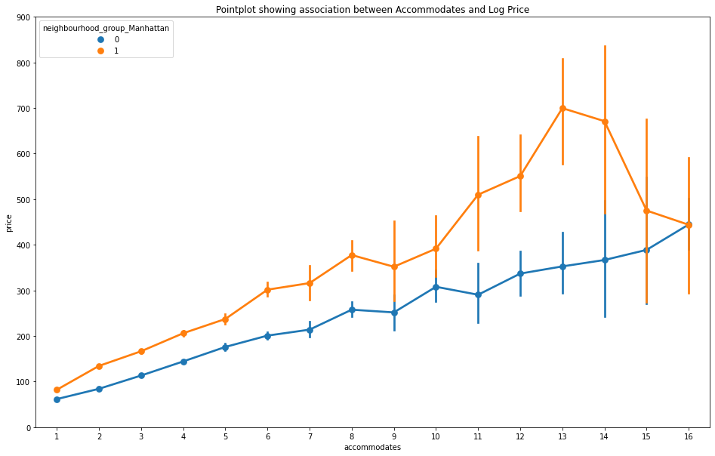
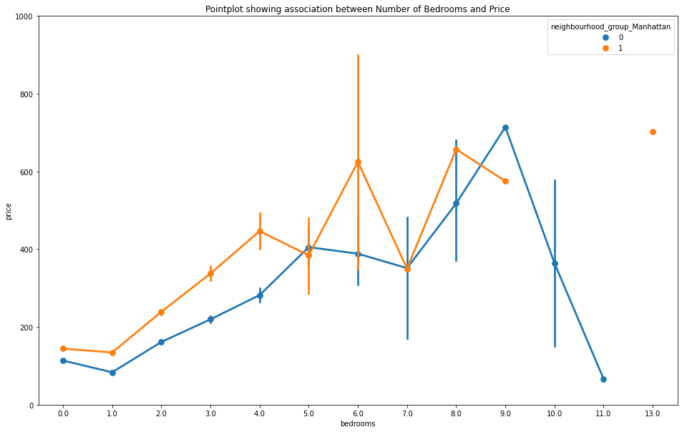
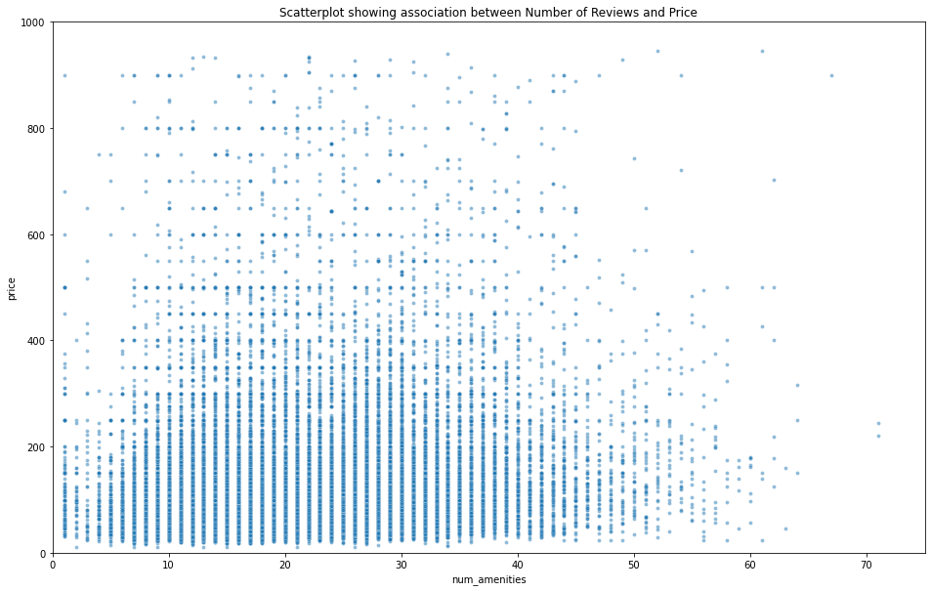
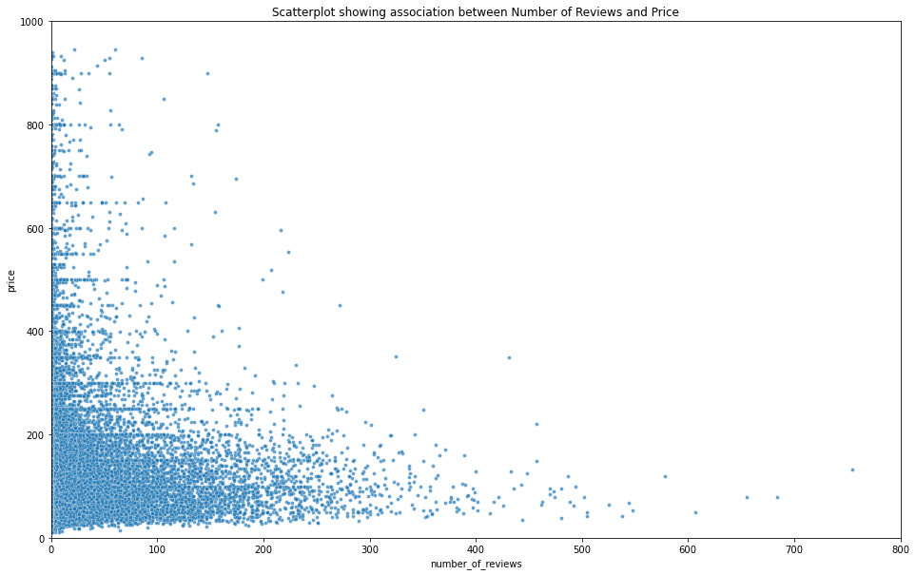
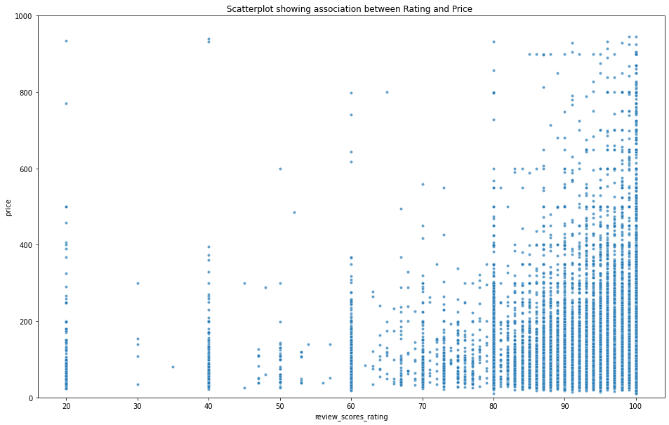
Distribution of Price and Other Features

Slide 9
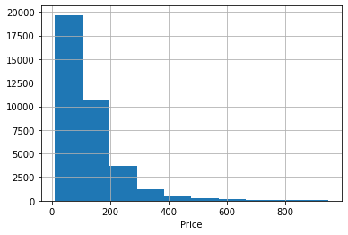
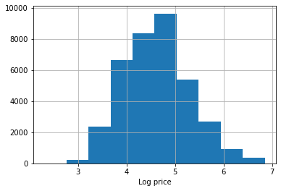
Target/Label - Price
35 listings had 0 prices
prices after 99th percentile consisted outlier values like $2,000
After this step, the price ranged between $20 and $946
Skewness Problem:
75% of samples - $20 - $156
25% of samples - $156 and $946
Removed
Price distribution before and after log transformation

Slide 10
Modeling Predicting Listings’ Prices
Numeric values were standardized
Data was split into train and test data (test-data = 0.25)
Performance metric: Mean Absolute Error (MAE)
Algorithm | Mean Absolute Error (train-data) | Mean Absolute Error (test-data)
Dummy Regressor (Median) | $67.60 | $67.61
Linear Regression | $48.27 | $49.24
Lasso Regression (α = 0.0001) | $48.28 | $49.25
Random Forest (number of estimators = 286; maximum depth = 10) | $43.40 | $45.95
Gradient Boosting – Finalized model (number of estimators = 50 and maximum depth = 7 | $41.17 | $45.20

Slide 11
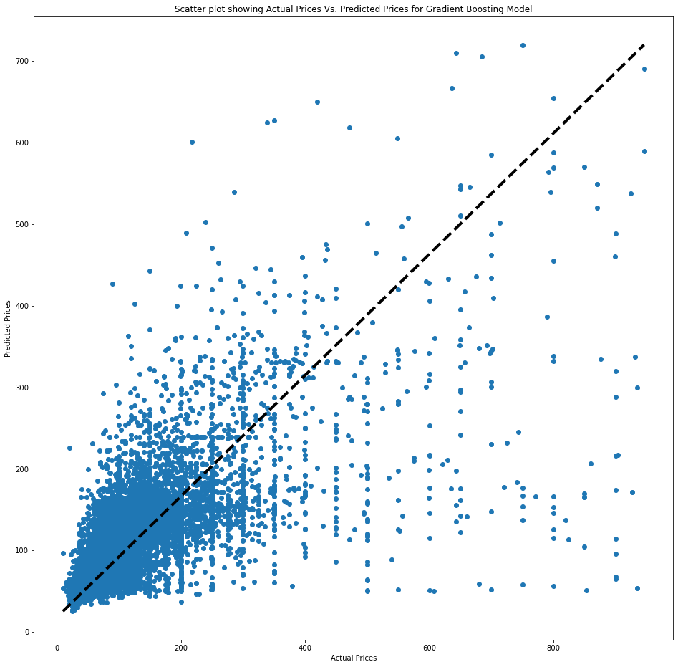
Comparing Actual Vs. Predicted Prices (using test-data)
Predicted
Prices
Actual Prices

Slide 12
Different Models for Different Price Ranges
Model for “Prices < $156”
Model for “Prices between $156 and $600”

Slide 13
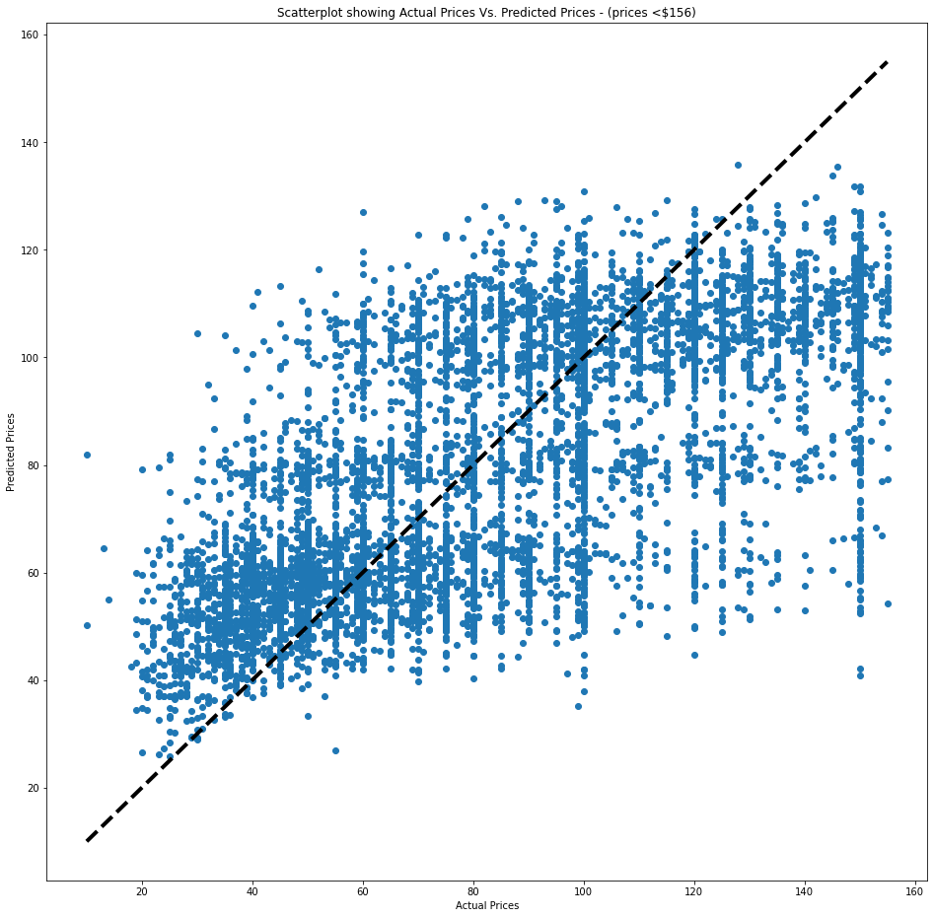
Modeling for Prices less than $156
Data was subset for prices < $156
n_estimators = 100, max-depth = 5.
MAE (train) = 19.64
MAE (test) = 20.49
Predicted
Prices
Actual Prices

Slide 14
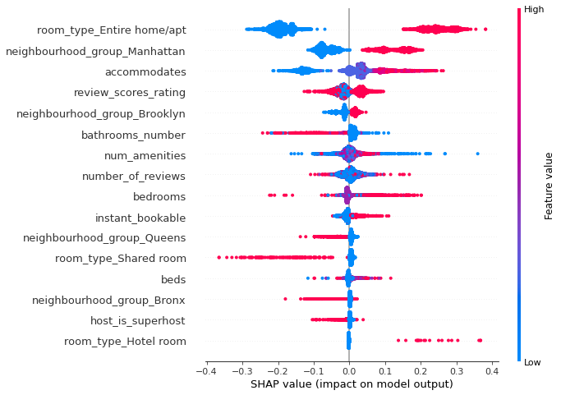
Modeling for Prices less than $156

Slide 15
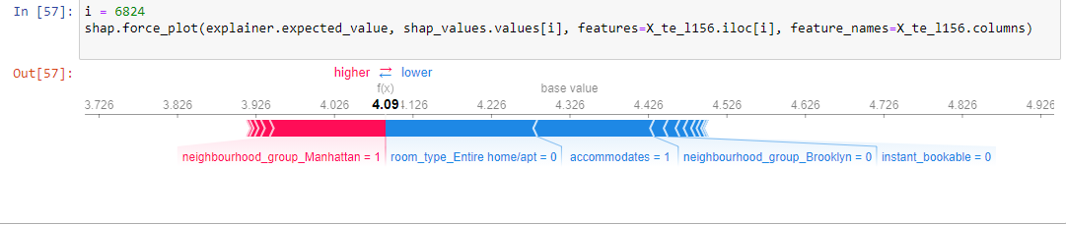
Modeling for Prices less than $156
Predicted Price = $59.8 and Actual Price = $59

Slide 16
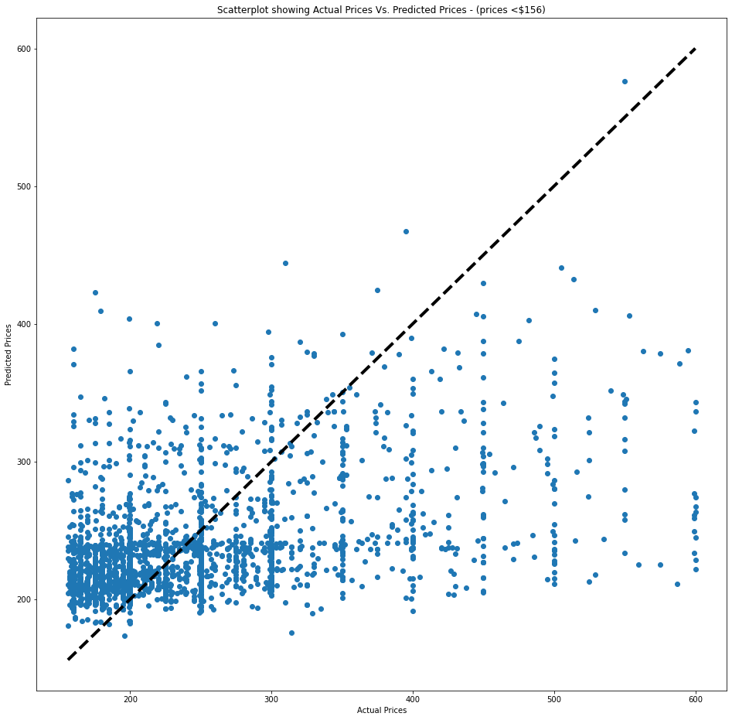
Modeling for Prices between $156 and $600
Data was sub-set for prices between $156 and $600.
n_estimators = 50 and max-depth = 5
MAE (train) $54.18
MAE (test) $57.45
Error Analysis:
Out of 2185 predictions, 11.4% of them have absolute error less than $10
61% of them had absolute error less than $50.
17 of them, most of their actual prices are close to $600, had absolute prediction error of $300.
Predicted
Prices
Actual Prices

Slide 17
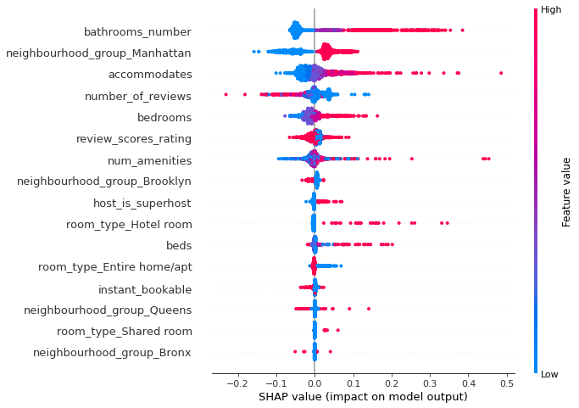
Modeling for Prices between $156 and $600

Slide 18
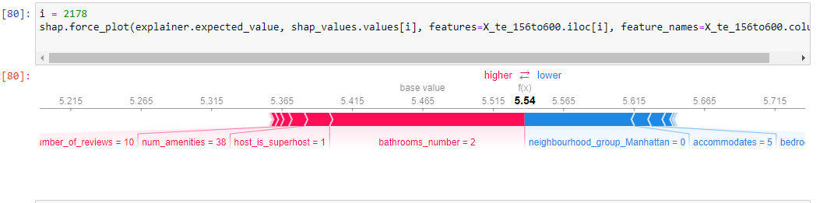
Modeling for Prices between $156 and $600

Slide 19
Limitations and Future Directions
Only applicable for Listings in New York area and for first quarter of the year
Imbalance (skewness) in data set, with large number of lower prices and small number of higher prices.
SMOTER- which is a minority class oversampling technique modified for continuous target feature/regression to handle unbalanced data (Torgo et al., 2013).
Lack of data on the demand side of the listings (seasonal changes, local events, and actual demand)
Analyze the text-data on reviews of listings
Calculate how far the listings are from tourist attractions and historic places, as distance between landmarks and listings has been found to influence prices (Perez-Sanchez et al., 2018)
Missing data on acceptance-rate and response-rate features
Count of amenities; not differentiated from each other.

Slide 20


